Slide 1

Introduction to RaBIDS
Where
When

Slide 2
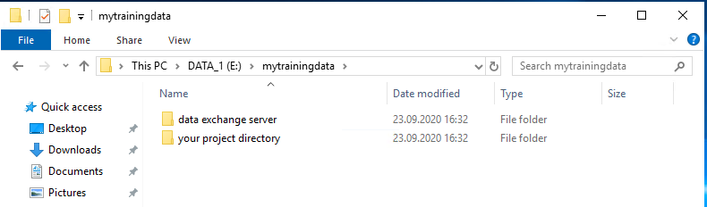
Data structure
Data exchange directory = hobbes
Your project directory = local project directory for analysis and self-archiving

Slide 3
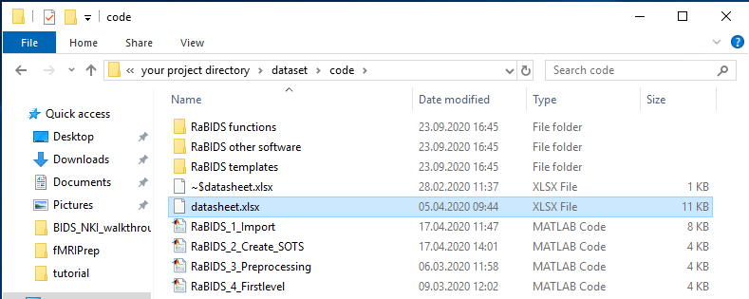
Data structure
Automated Import requires to fill in the datasheet.xlsx file.
This file contains descriptive information which is used by the matlab-based programs to navigate through paths, access subject data, and to interpret fMRI and logfile data.

Slide 4
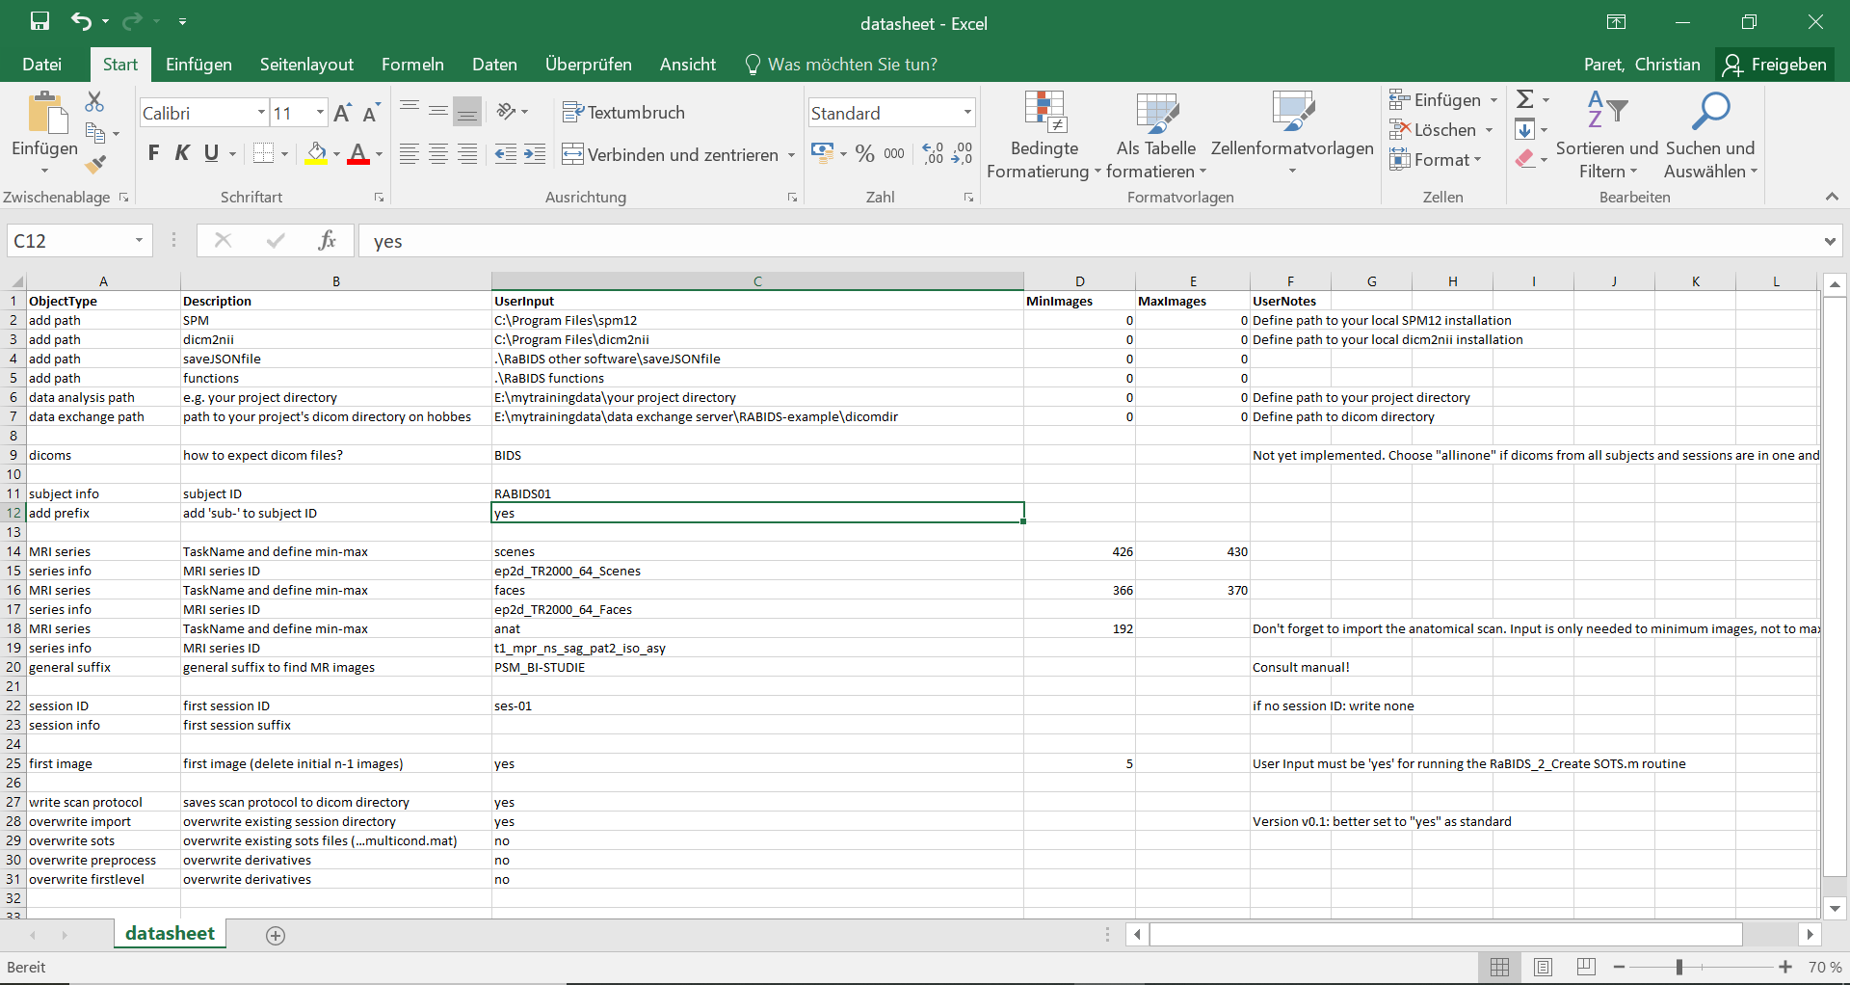
The datasheet-file

Slide 5
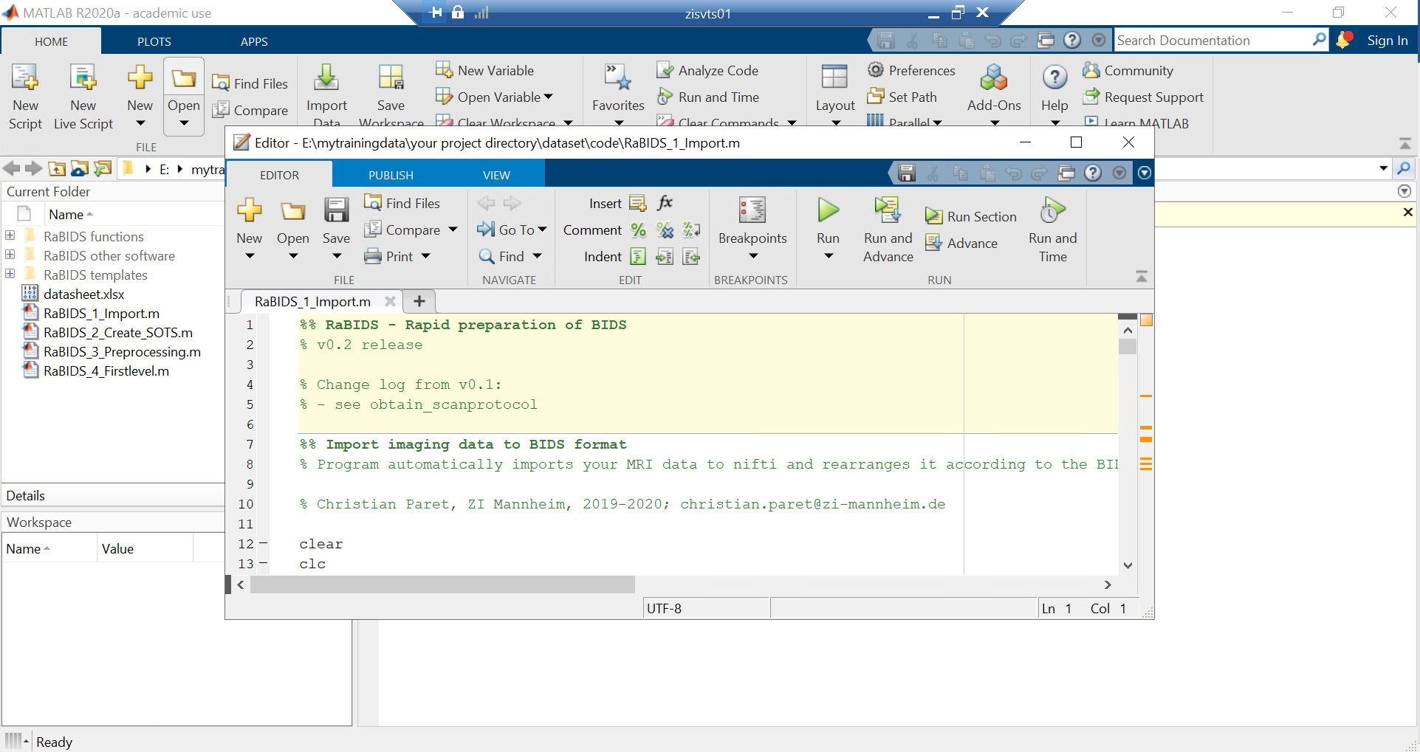
Import to BIDS
Run RaBIDS_1_Import.m:

Slide 6
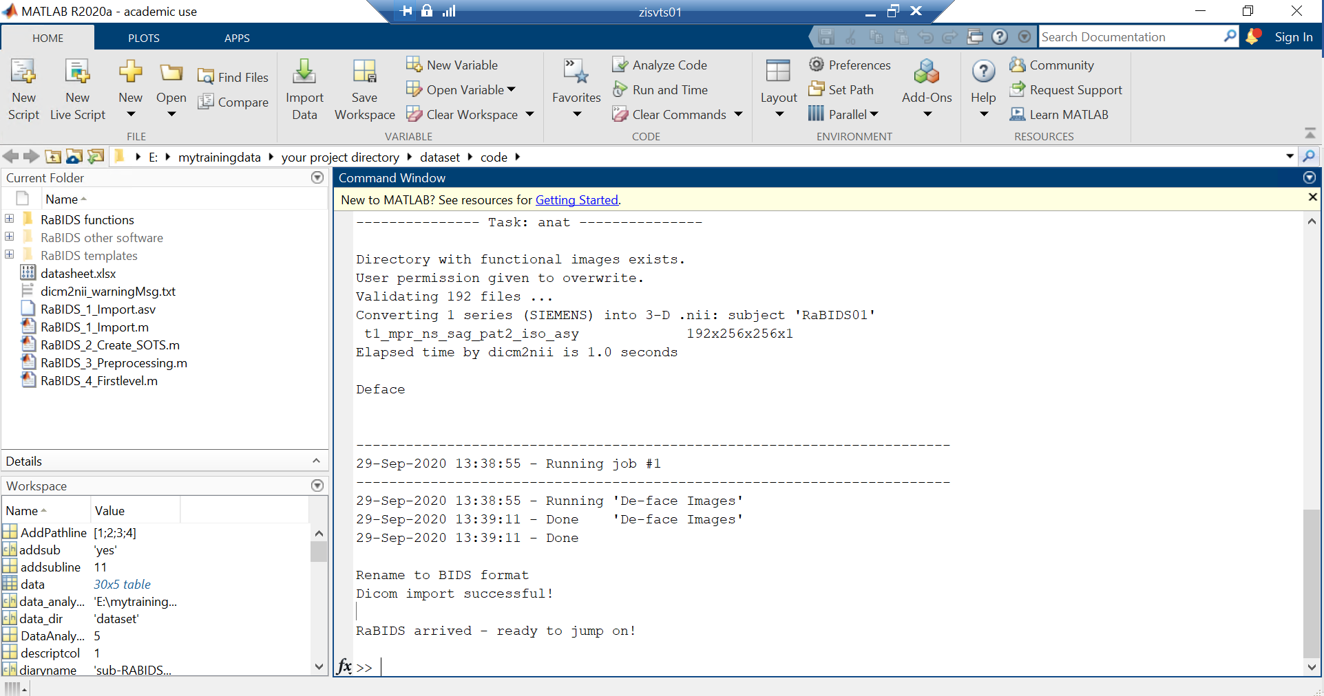
Import to BIDS
The command window returns information about the status:

Slide 7
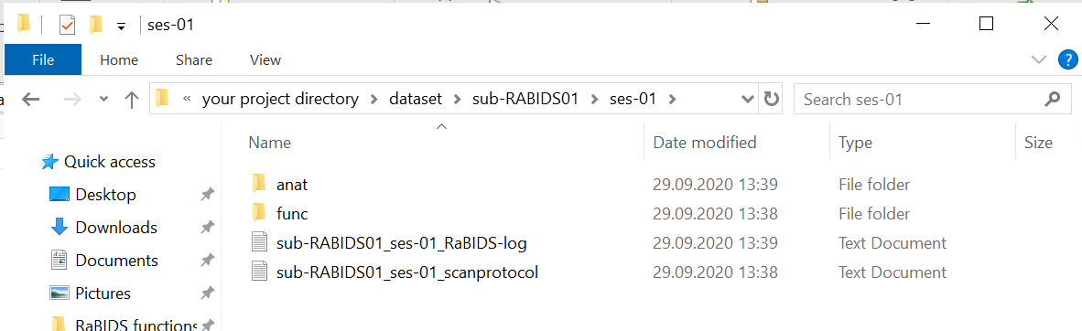
Import to BIDS
Successful import results in directories with nifti-images from anatomical (anat) and functional (func) runs. Additionally, a logfile with the command window output and the scan protocol is saved, listing MRI-series names with running number and volume information.

Slide 8
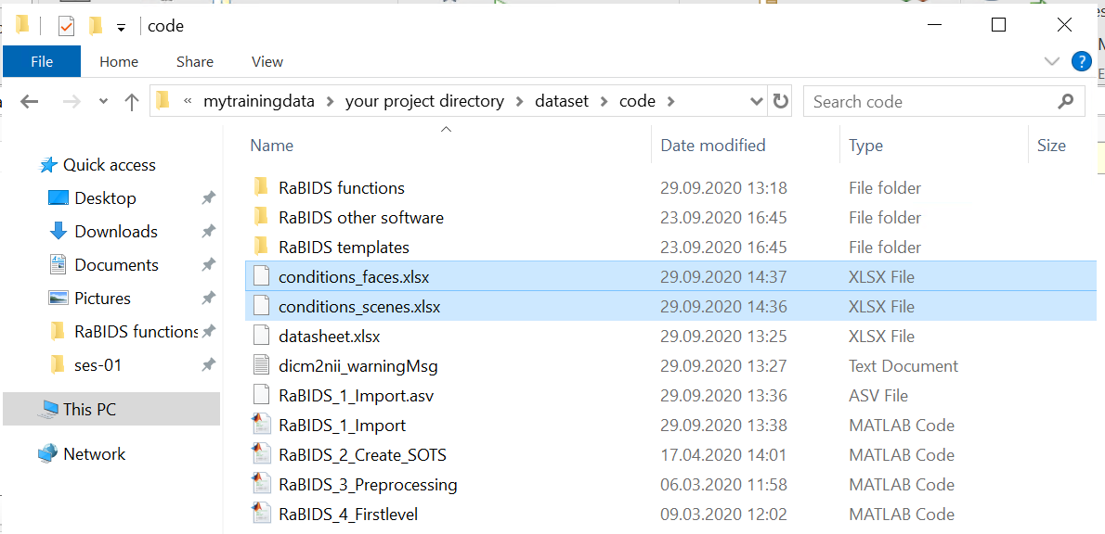
Create SOTs
Stimulus onset time (SOT) files are created automatically using RaBIDS_2_Create_SOTS using logfile information from the stimulus presentation software. In the current version this function works only with Presentation logfiles.
To use this function you need to specifiy parameters in a file called conditions_TaskName.xlsx. In below example, TaskNames of the two functional tasks are are faces and scenes.

Slide 9
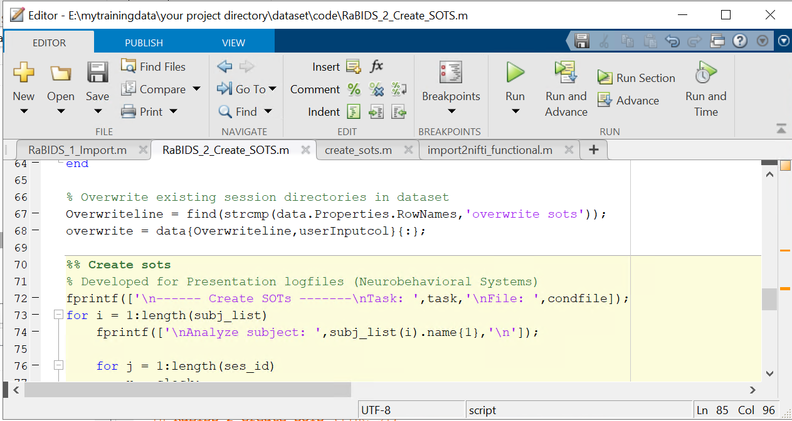
Create SOTS
Run RaBIDS_2_Create_SOTS.m:

Slide 10
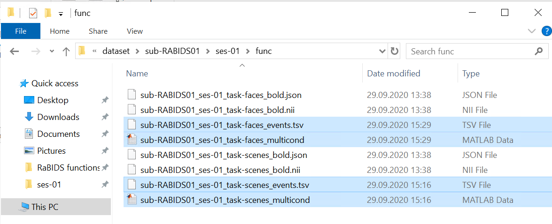
Create SOTS
Two files per task are created:
The events.tsv file is for BIDS compatibility
The multicond.mat file is compatible with SPM12 first-level analysis

Slide 11

Vielen Dank für Ihre Aufmerksamkeit
www.zi-mannheim.de
info@zi-mannheim.de

